Slide 1
Victoria Larson: Sprint Review
Analyzing, Understanding, & Summarizing Disease Data

Slide 2
3 data sets
20 minutes
3 questions
An ambitious goal…

Slide 3
Disease data!
Subsets.. Subsets… Subsets…
Question 1: What was the total Measles Count for Hawaii vs. the United States in 1960.
1b. Measles average (52 weeks) for entire USA in 1960
USMeasles_avg <- mean(Measles_1960$count)
Answer 8474.922
1a. Total Measles Count for Hawaii
Measles for all in 1960
Measles_1960 <- subset(Year_1960,disease=="Measles")
MeaslesHI_1960 <- subset(Measles_1960,state=="Hawaii")
HIMeaslesCount <-MeaslesHI_1960$count
Answer: 5322
Notes:
Hawaii’s disease data didn’t begin until 1960.

Slide 4
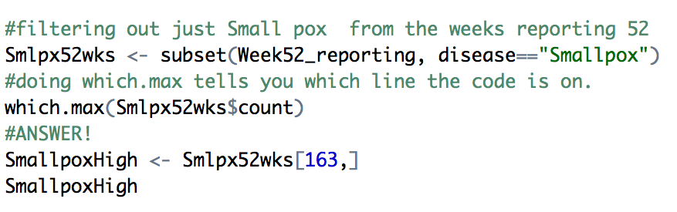
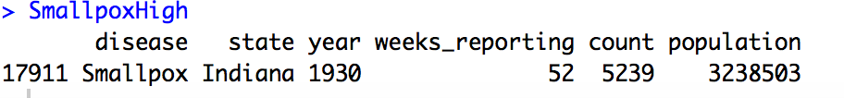
Question 2: Which state had the highest count (in 52 weeks) for each disease.
The First Trial… and error

Slide 5
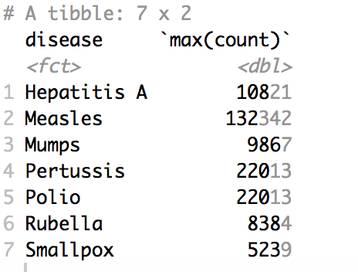
Then Ben found me.
Diseases %>% subset(weeks_reporting == 52) %>% group_by(disease) %>% summarise(max(count))

Slide 6
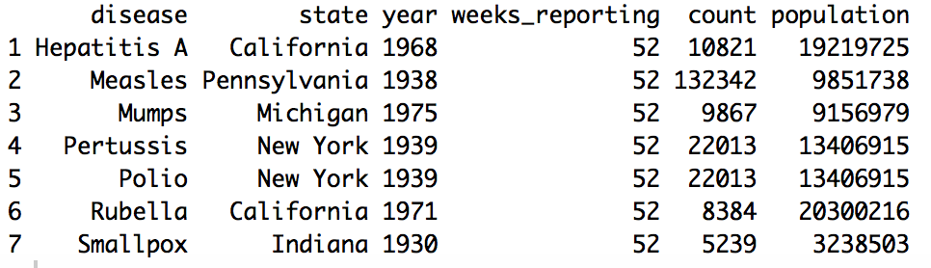
The ddply way:
DiseaseHigh <- ddply(Week52_reporting, 'disease', function(x) x[x$count==max(x$count),])

Slide 7
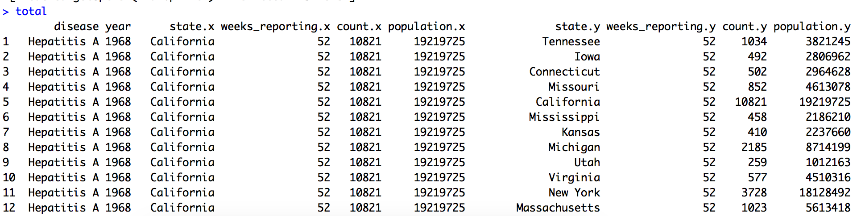
Question 2B: Compare the Year/State count to the Year/USA Count. What is the individual states overall percentage in relation to the nation.
total <- merge(DiseaseHigh, Week52_reporting, by=c("disease", "year"))

Slide 8
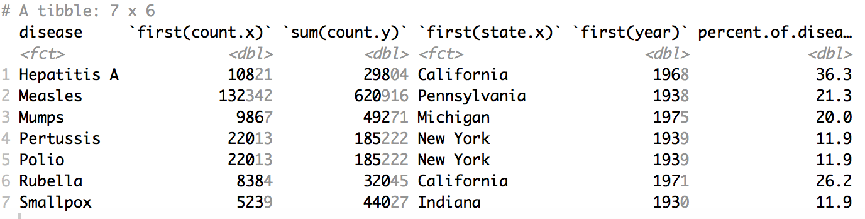
Behold….
Disease_percent = total %>% group_by(disease) %>% summarise(first(count.x), sum(count.y), first(state.x), first(year)) %>% mutate(percent.of.disease=`first(count.x)`/`sum(count.y)`*100)

Slide 9
Fun with GGPLOT
Week52plot <- ggplot(Week52_reporting, aes(x=year, y=count, color=disease)) + geom_point()
Week52plot <- (Week52plot + scale_color_manual(values = c("royalblue1", "green3", "violet", "red4", "darkorchid", "cyan1","coral")))
options(scipen = 10)

Slide 10
The End

